Slide 1
Mobile Ad-Hoc Networks
(MANET)

Slide 2
Ad-Hoc Networks
Create
Communicate
Destroy

Slide 3
Ad-Hoc Networks
ad hoc: made or happening only for a particular purpose or need, not planned before it happens.
The system does not rely on fixed infrastructure networks that needs an ad-hoc networks.
Network Type ? -- Multi-hop
Ad-hoc is useful when,
Instant Infrastructure.
Disaster relief.
Remote area.
Effectiveness required applications.

Slide 4
Ad-Hoc Wireless Networks
Temporary computer-to-computer connection.
No need of wireless access points to transfer the data.
You can share internet connections b/w computers.
More than one laptop (Node) can be connected with this networks.
The computers need to be within 100 meters of each other.
User can delete the network when it is no longer needed.

Slide 5
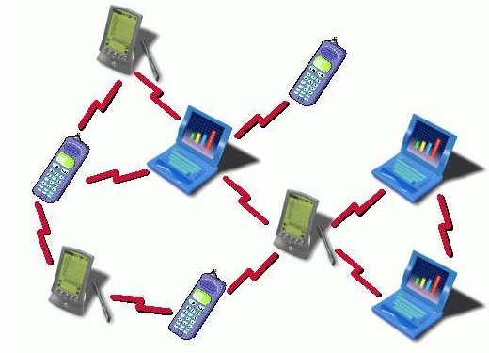
MANET [ Mobile Ad-hoc Network ]
It is an infrastructure less IP based network.
Administration is decentralized.
Manet node can act as [Sender, Receiver, Router].

Slide 6
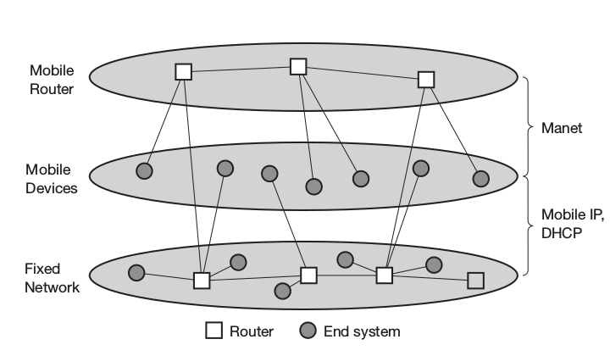
MANET and Mobile IP

Slide 7
MANET and Mobile IP
Mobile IP and DHCP is handled by infrastructure structure based networks.
Counterpart for this ad-hoc’s have mobile routers.
Mobile node has much more to have a routing and end system functionality too.
MANET research focuses on protocols that enable the mobile devices have the routing and end system functionalities.
Routing functions some time exists on networks layers 2 or 3.
Bluetooth is an best example for ad-hoc networks.

Slide 8
Schematic Model of Mobile Ad-Hoc
Application
Application
Application
Transport
Transport
Transport
Network
Network
Network
Link
Link
Link
Wireless Link
Wireless Link
Source
Intermediate Node
Destination

Slide 9
Characteristics of MANET
Lack of fixed infrastructure.
Dynamic Topologies.
Bandwidth constrained, variable capacity links.
Fading, noise, Interference.
Energy Constrained Operation.
Increased Vulnerability.
Eavesdropping, Spoofing, DoS
Distributed peer-to-peer mode of operation.
Multi-hop routing.
Frequent changes on the connection relative to the area.

Slide 10
MANETS Operational Constraints
Low Processing Capabilities.
Low Bandwidth wireless links.
Low Storage.
Low battery power.
Flooding is unacceptable.
Periodic messages required for reliable connections.
Route alteration must be made quickly.
Best protocols needed to satisfy all these problems.

Slide 11
Applications of MANET
Communication among portable computers.
Environmental monitoring.
Data collectors from remote location.
Security Monitoring.
Road Traffic Monitoring.
Sensors that detects the weathers, and presence of some animals.
Energy efficient systems.
Military.
Information collection from military vehicles, soldiers,headquarters.
Future possibility for automated parts and its applications.
Emergency Applications.
Natural disasters.
Re-Establishment of connection with traditional networks.

Slide 12
MANET Design Issues
Network size and node density.
Network size = coverage area of the network.
Network density= no of nodes presents in that geographical area.
Clustering requires to keep low on overheads in communications in a larger networks.
Clustering size depends on the density of the network.
Connectivity
Connectivity refers no of neighbour nodes.
Link capacity is based on connectivity.
It is keep on changing.

Slide 13
MANET Design Issues
Network Topology
Connectivity among the nodes is also known as topology.
Mobility make topology more dynamic.
Node’s can become inoperative due to discharge of batteries or hardware failures.
User Traffic
MANET Designing is carried based on,
Node density.
Average rate of node movements.
Expected Traffic.
Types of Traffic
Bursty Traffic.
Large packets sent periodically.
Combination of Both.

Slide 14
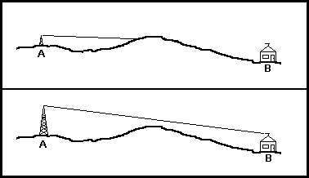
MANET Design Issues
Operational Environment
Environment may differ,
Urban
Rural
Maritime.
Most of these requires the line of sight (LoS) communication system.
Node density differs all the time MANET may suit for this.
Energy Constraints
No infrastructure so no reliable power source.
Extra roles like routers.
Routing workload drains the batteries quickly.
Node must be kept in sleeping mode when the overhead occurs to save the batteries.

